Slide 1
A summary of the NRS publication Joshua Bird Statistician 28 October 2022
Drug misuse deaths in
Scotland in 2021

Slide 2
Contents
Terminology
Headlines
Demographics
Deprivation
Geography
Substances

Slide 3
A note on terminology
Previous editions of this report referred to the headline figure as ‘drug-related deaths’.
Change in terminology – now using the term ‘drug-misuse deaths’.
Brings Scotland’s terminology in line with that used in other parts of the UK.
The definition has not changed – same definition that’s been used since 2001 – figures are consistent with earlier years.
NRS identify deaths which should be counted as drug misuse from death registration records. Additional information from COPFS, forensic pathologists and medical experts at PHS.

Slide 4
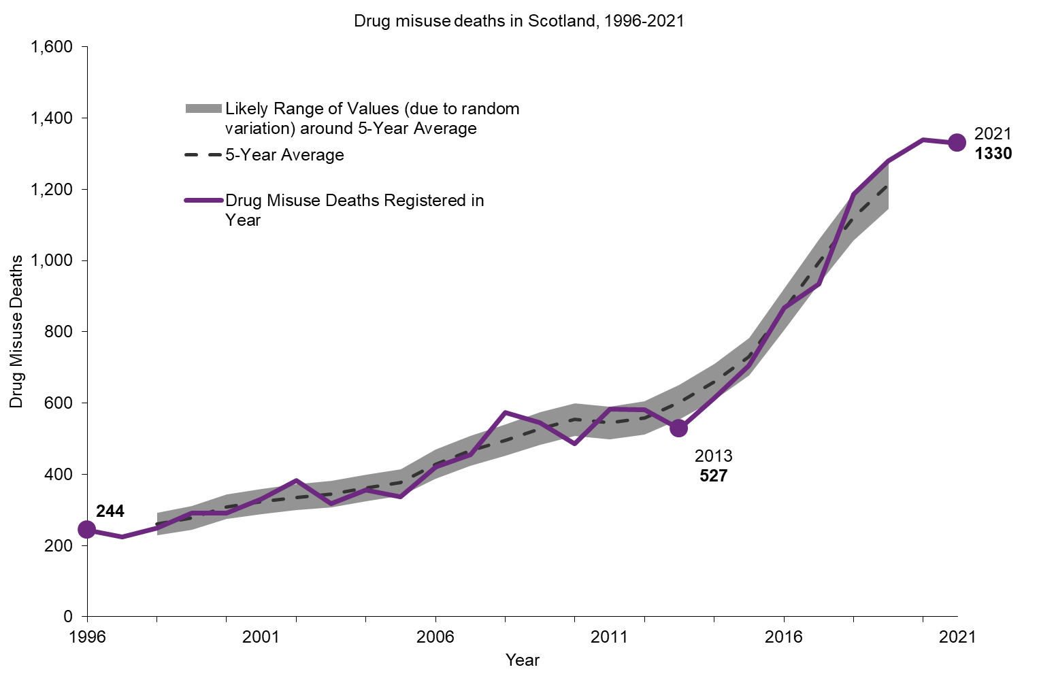
Drug misuse deaths in Scotland remain very high
1,330 drug misuse deaths in 2021.
Down 1% (9 deaths) on 2020.
Second highest figure on record but first fall in 7 years.
Over 12,000 drug misuse deaths since 2007. (Total 2007-2021: 12,009).
General profile of drug misuse deaths broadly in line with previous years – but note females, poly drug use and regional detail.
Notes:
Next: sex

Slide 5
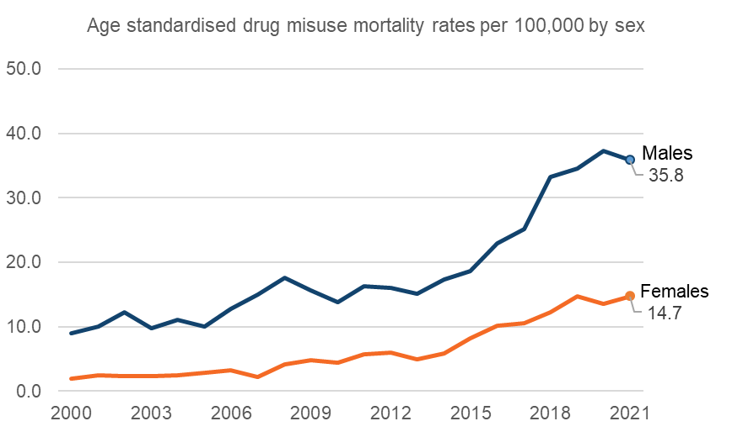


Males were 2.4 times as likely to have a drug misuse death as females – but the gap is narrowing
Males
933 deaths in 2021 (70%)
Down 40 (4%) on 2020
Rate: 35.8 per 100,000
Females
397 deaths in 2021 (30%)
Up 31 (8%) on 2020
Rate: 14.7 per 100,000
In 2021, after adjusting for age, males were 2.4 times as likely to have a drug misuse death as females.
But the gap is narrowing – drug deaths amongst females increasing.
Substance profile and geography broadly similar for males and females.
Average age is similar for males and females (43.2 and 44.6 respectively).
Notes:
Next: age

Slide 6
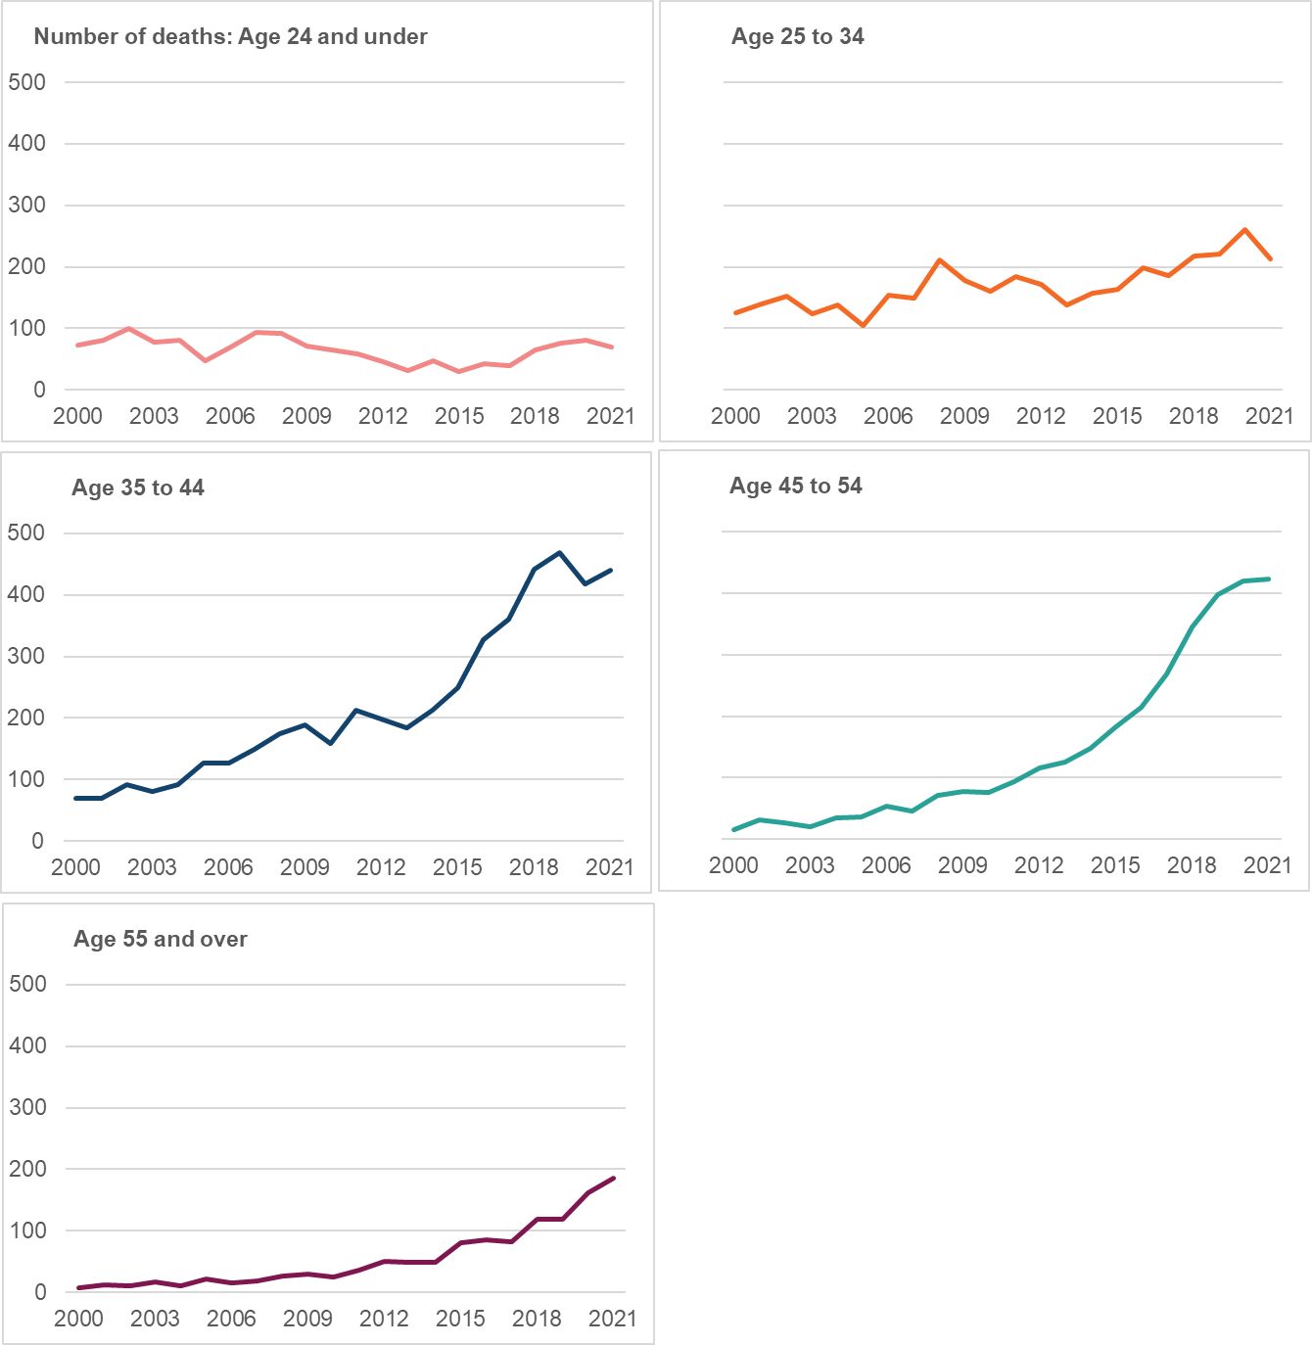
Almost two thirds (65%) of drug misuse deaths in 2021 were of people aged between 35 and 54
The average age of drug misuse deaths in 2021 was 44 (2020: 43).
Drug misuse death rate highest for those aged 35-44 (63.5 per 100,000, up from 61.5 in 2020). This age group has had the highest drug-related death rate for the past 10 years.
Deaths fell 13% in the under 25 age group after 3 years of increases. 70 deaths in 2021 (2020: 80 deaths), caution interpreting – fairly small numerical change.
In 2021, people aged 35-44 were over 5 times as likely to have a drug misuse death as those in the 15-24 age group.
Charts show the number of drug misuse deaths in each age band in 2021; rates follow a similar pattern.
Notes:
Next: deprivation

Slide 7
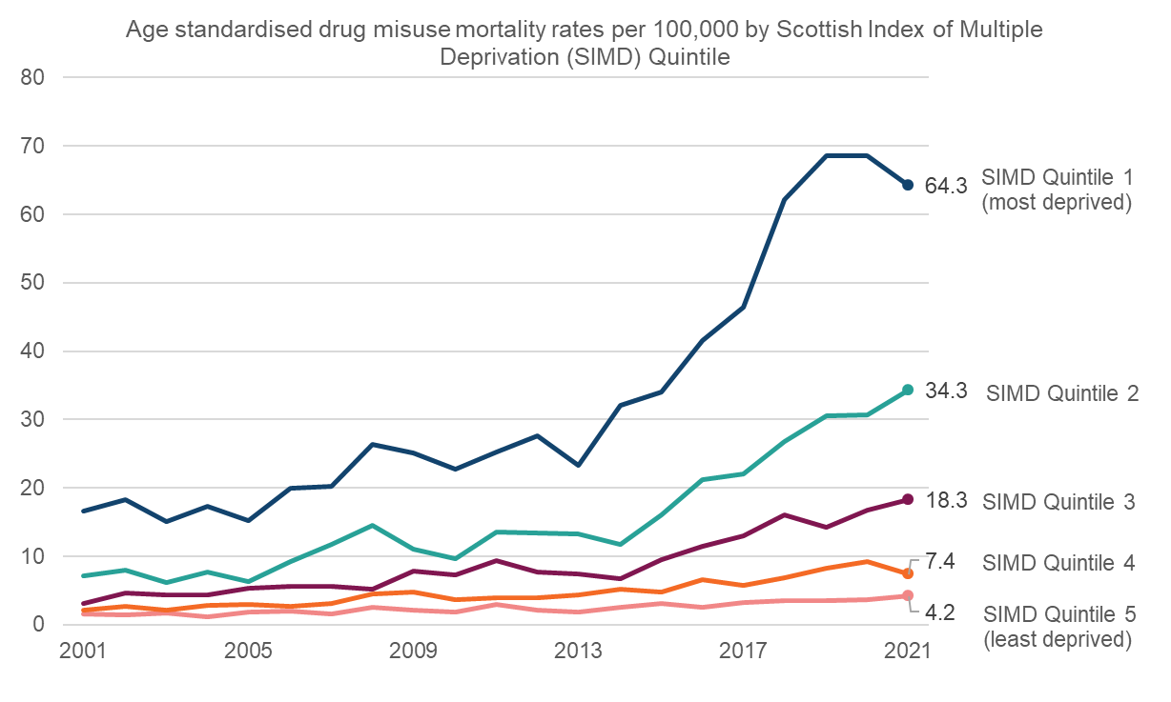
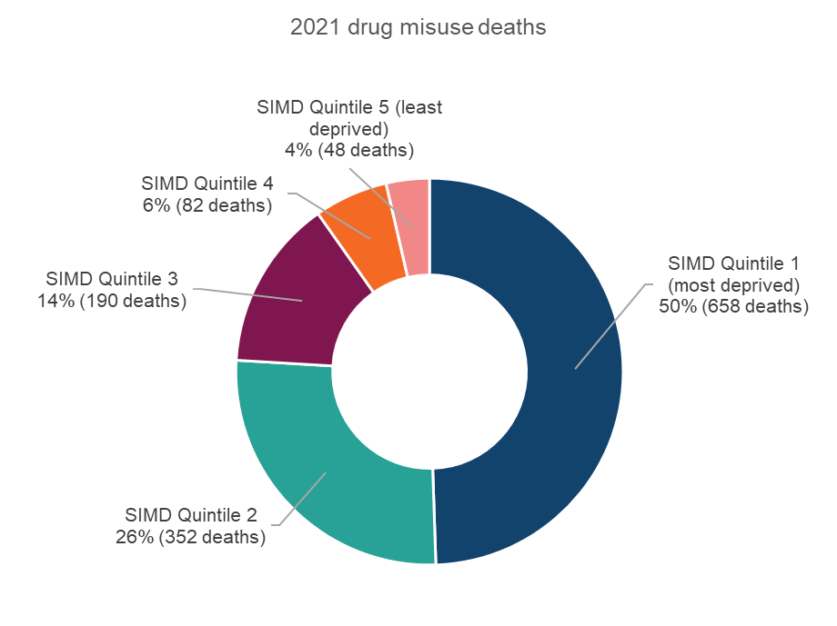
People in the most deprived areas were over 15 times as likely to die from drug misuse as those in the least deprived areas
In 2021, after adjusting for age, people in the most deprived areas were 15.3 times as likely to die from drug misuse as those in the least deprived areas.
Ratio has widened over the past two decades (in the early 2000s it was around 10 times).
Gap has narrowed slightly in the last year – fall in death rate in most deprived quintile (2020: 68.5, 2021: 64.3) - but caution in drawing any conclusion on longer term trend here.
Half of drug misuse deaths are in the most deprived quintile.
Notes:
Next: geographical view - gets messy – high level using NHS health boards then council area to align better with accountability and way funding is divvied up

Slide 8
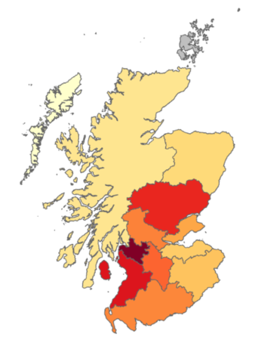

1 in 3 drug misuse deaths in 2021 were in NHS GGC where the death rate is around 1 ½ times that for Scotland as a whole
Drug misuse death rates in Greater Glasgow & Clyde (33.7), Ayrshire & Arran (28.1), Tayside (27.1) and Lanarkshire (23.7) are higher than the Scotland average (22.9). 2017-2021 average age standardised rate per 100,000 population.
In 2021, NHS Boards with largest % reductions in number of drug misuse deaths on 2020 levels were Tayside (down 16, 15%), Highland (down 5, 10%) and Forth Valley (down 8, 10%).
In 2021, the largest percentage increases in the number of drug misuse deaths were in Dumfries & Galloway (up 13, 59%), Lothian (up 21, 13%) and Grampian (up 11, 11%) but interpret with caution due to small numbers.
Age standardised drug misuse deaths per 100,000 population by NHS Board area. Average over 5 years 2017-2021. Excludes Shetland. Rates based on fewer than 10 deaths not shown.
NHS GGC makes up c.22% of Scotland’s population.
Notes:
Next – council area -

Slide 9
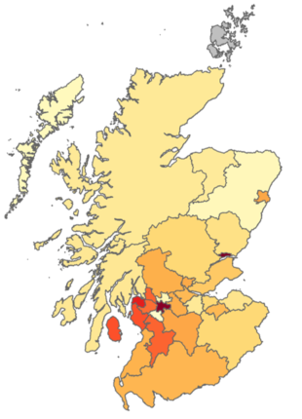
Almost 1 in 4 drug misuse deaths in 2021 were in Glasgow City
In 2021, five council areas made up half of all drug misuse deaths in Scotland (Glasgow City, City of Edinburgh, South Lanarkshire, North Lanarkshire & Fife).
Dundee City
52 deaths, down 5 (9%) on 2020
Average 5-year death rate 45.2
In City of Edinburgh, drug misuse deaths increased by 17 (18%) on 2020 (2021: 109, 2020: 92). In Glasgow City, deaths increased by 20 (7%) to the highest ever level.
In 2021, council areas with largest % fall on 2020 levels were Inverclyde (down 17, 52%), Stirling (down 15, 48%), Argyll & Bute (down 7, 44%) and Perth & Kinross (down 14, 41%), but interpret with caution, small numbers.
Glasgow City
311 deaths, higher than any previous year, up 20 (7%) on 2020
Average 5-year death rate 44.4
In 2021, the largest % increases were in Moray (up 7, 70%), Clackmannanshire (up 6, 67%) and Dumfries & Galloway (up 13, 59%) but interpret with caution, small numbers.
Graph shows age standardised drug misuse deaths per 100,000 population by council area. Average over 5 years 2017-2021. Excludes Shetland. Rates and comparisons with prior year based on fewer than 10 deaths not shown.
Notes:
This gives a detailed council area view so more closely aligned with how money is spent / accountability
Next – changes in drug misuse death rates over recent years

Slide 10
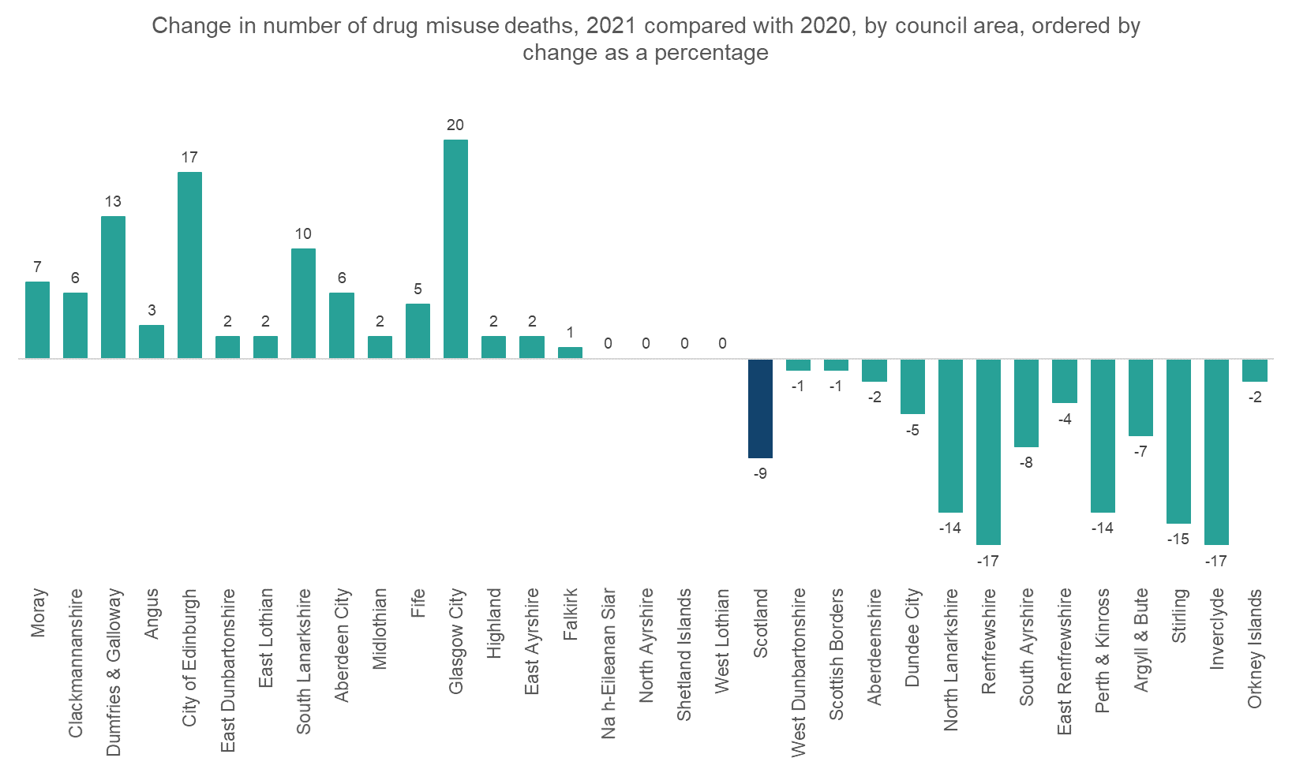
Of the 4 biggest cities, only Dundee City had fewer drug misuse deaths in 2021 than 2020
Notes:
Next – changes in drug misuse death rates over recent years – looking at both rates and patterns over recent years

Slide 11
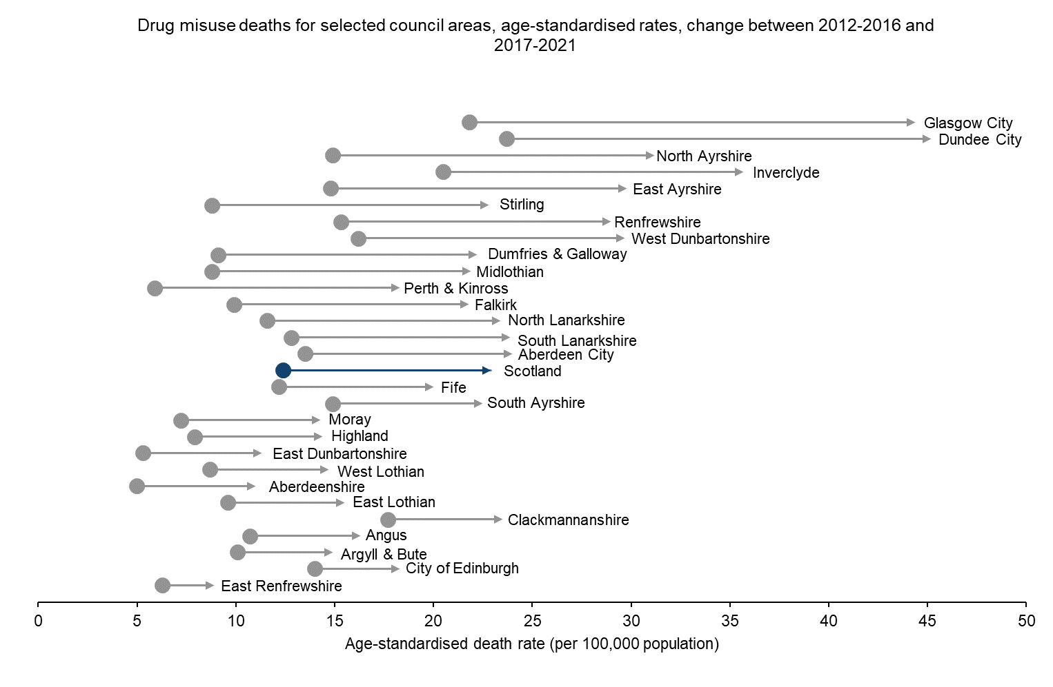
Over recent years, the greatest increases in drug misuse death rates have been in Glasgow City and Dundee City
Over recent years drug misuse death rates in Glasgow City have more than doubled, rising from 21.8 per 100,000 in the period 2012-2016 to 44.4 per 100,000 in 2017-2021.
Dundee City (23.7 to 45.2) and North Ayrshire (14.9 to 31.2) had the next biggest increases.
Comparable rates for Scotland as a whole increased from 12.4 to 22.9.
Note: this chart differs from Figure 6b in the NRS publication. Here we focus on a shorter, more recent period.
Notes:
This gives a detailed council area view so more closely aligned with how money is spent / accountability
Next: higher level view – substances

Slide 12

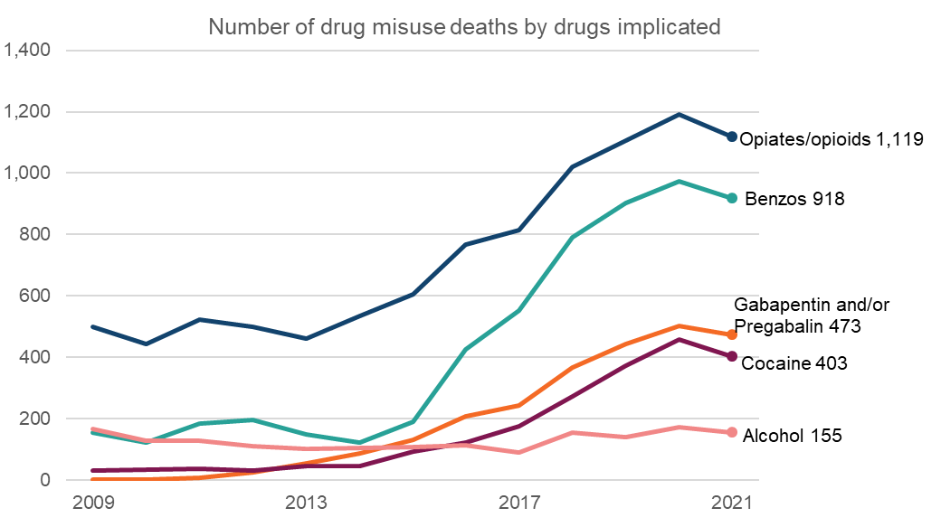



Most drug misuse deaths are of people who took more than one drug
More than one drug found to be present in the body in 93% of drug misuse deaths in 2021 (2020: 93%)
Opiates/opioids present in 84% (1,119) of drug misuse deaths (2020: 89%, 1,192 deaths)
Benzodiazepines present in 69% (918) of drug misuse deaths (2020: 73%, 974 deaths)
Opiates/opioids continue to dominate; rapid rise in implication of benzos since c.2015 – mostly street benzos.
Vast majority of deaths involve more than one substance
Alcohol – fairly stable number, reducing proportion.
Profile of substances implicated very similar for males and females.
Cocaine present in 30% (403) of drug misuse deaths (2020: 34%, 459 deaths)
Notes:
Next: focus on opiates / opioids

Slide 13
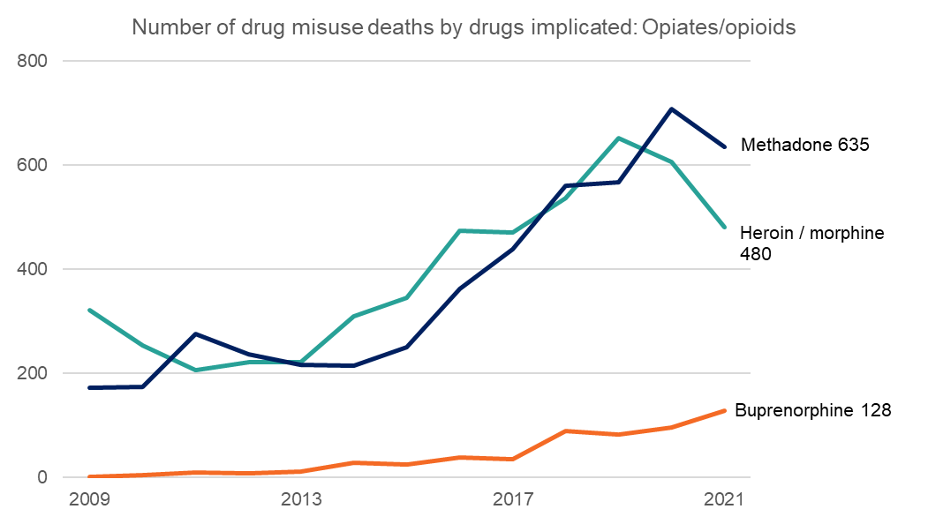
Methadone was the most commonly implicated opiate/opioid in drug misuse deaths in 2021
Opiates/opioids implicated in 84% (1,119) of deaths (2020: 89%, 1,192).
Methadone most commonly implicated opiate/opioid (635 deaths, 48%) but a drop on 2020 level (708 deaths, 53%). 9 deaths where methadone was the only drug implicated (2020: 7).
Buprenorphine was the only opiate/opioid where number of deaths increased – implicated in 128 deaths (10%) in 2021 (2020: 97 deaths, 7%). Increase of almost a third but caution interpreting – fairly small numbers.
Notes:
Next: focus on benzos

Slide 14
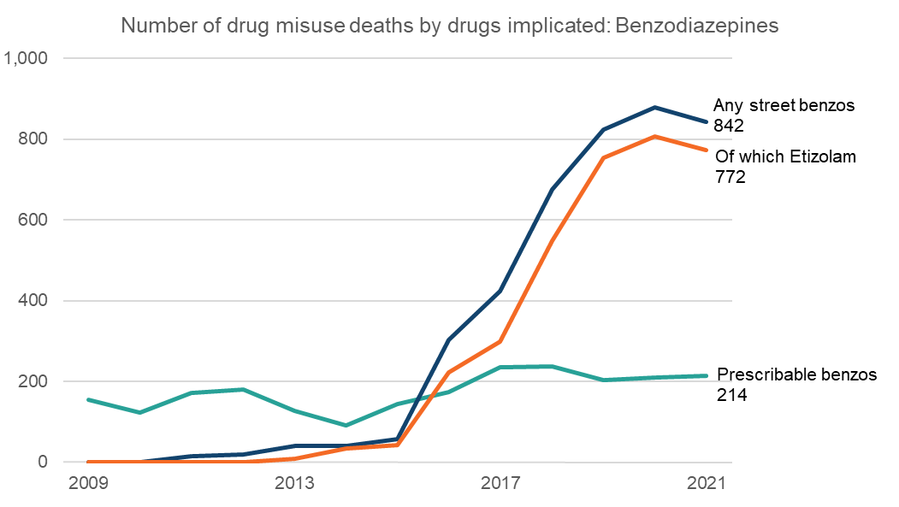
Almost two thirds of drug misuse deaths involve street benzodiazepines
Benzodiazepines implicated in 69% (918) of deaths. Slight drop on 2020 level (2020: 73%, 974).
Vast majority is street benzos (842 deaths, 63%), this was 37 (4%) fewer than in 2020 (2020: 879 deaths, 53%). Vast majority etizolam.
Number of deaths where prescribable benzos implicated remains fairly stable.
Notes:
Next: focus on other key drugs

Slide 15
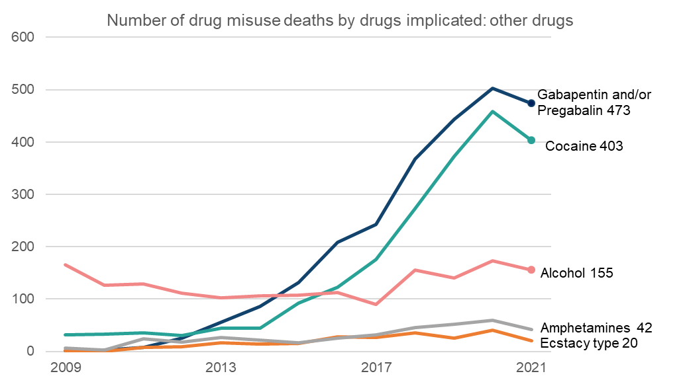
Cocaine was implicated in 1 in 3 drug misuse deaths; similar picture for gabapentin/pregabalin
Cocaine: 30% (403) of drug deaths in 2021 (2020: 459 deaths, 34%).
Gabapentin/pregabalin: 36% (473) of drug deaths in 2021 (2020: 502 deaths, 37%).
Number of deaths where alcohol implicated (in addition to a controlled drug) has remained fairly stable but the proportion has reduced (2021: 155 deaths, 12%; 2020: 173 deaths, 13%).
Fewer deaths where ecstasy type drugs implicated (2021: 20 deaths, 2020: 40).
Notes:
Next: tie up a few other things – UK comparisons, covid, suspected drug deaths

Slide 16
UK comparisons, suspected drug deaths and COVID-19
UK Comparisons
Scotland's drug misuse death rate in 2020 was 3.7 times the rate for the UK as a whole.
An updated UK comparisons analysis will be prepared following the Office for National Statistics publication of the 2021 drug death figures for England & Wales in August 2022.
Suspected drug deaths (Police Scotland)
Suspected drug death data published quarterly by SG is management information based on operational data from Police Scotland - very different in nature to National Statistics.
Historically (since 2018 when data became available), Police Scotland suspected drug deaths have correlated very closely with the NRS drug death statistics, with the rolling 12 month Police Scotland suspected drug death figures ranging between 3% and 6% above the NRS drug misuse death figures.
However, this relationship has not been borne out in 2021 - suspected drug deaths showed a 8% drop in 2021 vs 2020 whereas the NRS statistics show just a 1% drop.
Plan to reconvene the drug death data group with partner organisations (SG, NRS, Police Scotland and PHS) to investigate and review.
Drug deaths and COVID-19
In 2021, there were no drug misuse deaths which had COVID-19 mentioned on the death certificate.
There were 2 drug poisoning deaths where COVID-19 was mentioned as a contributory factor on the death certificate.

Slide 17
Drug misuse deaths in Scotland in 2021
1,330 drug misuse deaths in 2021, down 1% (9 deaths). Second highest on record.
People in the most deprived areas were over 15 times as likely to die from drug misuse as those in the least deprived areas.
1 in 3 drug misuse deaths in 2021 were in NHS Greater Glasgow & Clyde.
Most drug misuse deaths are of people who took more than one drug. More than one drug found to be present in the body in 93% of deaths.
Dundee City had the highest average drug misuse death rate in Scotland over 2017-2021 at 45.2 deaths per 100,000
2021 drug misuse age-standardised death rate 25.0 per 100,000 population.
Males 2.4 times more likely than females to have a drug misuse death. Deaths amongst women are rising.
Opiates/opioids were implicated in 84% of deaths. Methadone was the most commonly implicated opiate/opioid.
Average age of drug misuse deaths in 2021 was 44 (2020: 43).
In 2021, almost two thirds of drug misuse deaths (65%) were people between 35 and 54 years of age.
Benzos were implicated in 7 out of every 10 drug misuse deaths. Cocaine was implicated in 1 in 3 drug misuse deaths.

